Slide 1
Client & Stakeholder Relations
Made by Sarina Ariamanesh
11-314a

Slide 2
Introduction
Client and stakeholder relations are crucial for businesses' success and sustainability. Positive client relations lead to customer satisfaction, loyalty, and retention, while stakeholder relations, including investors, employees, suppliers, and the community, significantly impact the organization. Maintaining positive stakeholder relations enhances a company's reputation, fosters collaboration, and contributes to long-term success.

Slide 3
Communication with Clients/Stakeholders
Clear and effective communication is crucial for successful relationships in both professional and personal spheres. It prevents misinterpretation, enhances productivity, builds trust, facilitates decision-making, and enhances relationships. Active listening and understanding needs are essential for problem-solving and relationship enhancement. Communication channels include face-to-face meetings, email, instant messaging, videoconferencing, social media, project management software, and surveys.

Slide 4
Building Rapport
Building rapport with clients and stakeholders is crucial for the success of any project or business endeavor. It involves establishing a positive and mutually beneficial relationship based on trust, empathy, and understanding. Here’s why it is important:

Slide 5
Empathy and Understanding: Empathy and understanding foster trust and connection with clients and stakeholders, valuing their perspectives, concerns, and needs, ultimately resulting in stronger relationships.
Trust-Building: Trust is the cornerstone of successful relationships, built on consistent commitment, transparency, and integrity, fostering open communication, collaboration, and a commitment to shared objectives.
Effective Communication: Building rapport fosters effective communication, allowing clients and stakeholders to express their thoughts, concerns, and expectations openly, leading to better understanding and alignment of goals, ultimately improving project outcomes.

Slide 6
Collaboration and Problem-Solving: Strong relationships foster collaboration, teamwork, and problem-solving by fostering trust, respect, and diverse perspectives among clients and stakeholders, ultimately leading to project success.
Client Satisfaction and Loyalty: Building rapport with clients leads to increased satisfaction and loyalty, as they feel understood, supported, and valued, resulting in repeat business, referrals, and advocacy.
Long-Term Partnerships: Building strong client and stakeholder relationships can foster long-term partnerships, ensuring stability, continuity, growth opportunities, and mutual success.

Slide 7
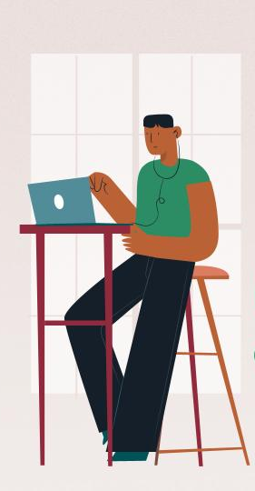
Client Feedback and Satisfaction
Gathering client feedback is vital for businesses to improve products or services, identify customer needs, improve product quality, enhance customer satisfaction, and stay ahead of competitors. It helps identify trends, spot emerging needs, and adapt to changing customer demands. Businesses can collect feedback through surveys, interviews, customer reviews, and feedback forms. Addressing customer concerns promptly and effectively builds trust, retaining customers, and preventing negative word-of-mouth.

Slide 8
Managing Expectations
Setting realistic expectations is crucial for successful project management and stakeholder relationships. It builds trust, manages satisfaction, prevents misunderstandings, enhances efficiency, and improves relationships. Misaligned expectations can lead to conflicts, overcommitment, and underutilization.

Slide 9
Setting Clear Goals and Deadlines
Clear goals and deadlines are essential for effective project management and success. They align expectations, provide focus and direction, establish accountability, optimize resource management, mitigate risks, facilitate communication, and contribute to overall project efficiency. They also aid in risk management, project planning, and stakeholder management. By setting specific milestones and ensuring regular updates, businesses can maintain trust and engagement, ultimately leading to a more successful project.

Slide 10
Regular Progress Updates
Regular progress updates are vital for transparency, stakeholder involvement, managing expectations, identifying problems early, building trust, facilitating collaboration, decision-making, and managing project risks. They demonstrate openness, honesty, and commitment to transparency, enhancing project outcomes and client satisfaction.

Slide 11
Conflict Resolution
Conflict resolution is crucial for maintaining positive relationships and project success. Strategies include open communication, active listening, problem-solving, mediation, compromise, and documenting agreements. These methods encourage open expression of concerns, build rapport, break down conflicts into specific issues, and ensure clarity for future discussions, ultimately fostering collaboration and project success.

Slide 12
Conclusion
The presentation emphasizes the importance of strong client and stakeholder relations for business success. Key takeaways include building strong relationships, improving communication strategies, fostering strategic collaboration, adapting to client needs, and continuously improving engagement strategies.

Slide 13

Thanks for your attention!

